Slide 1


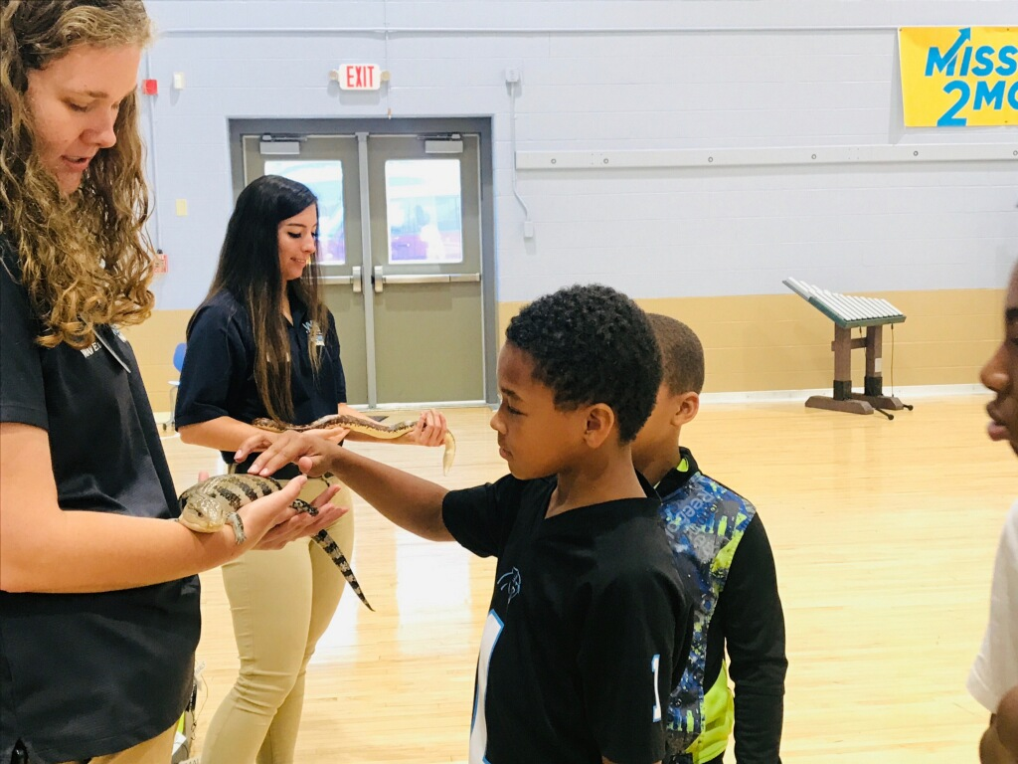
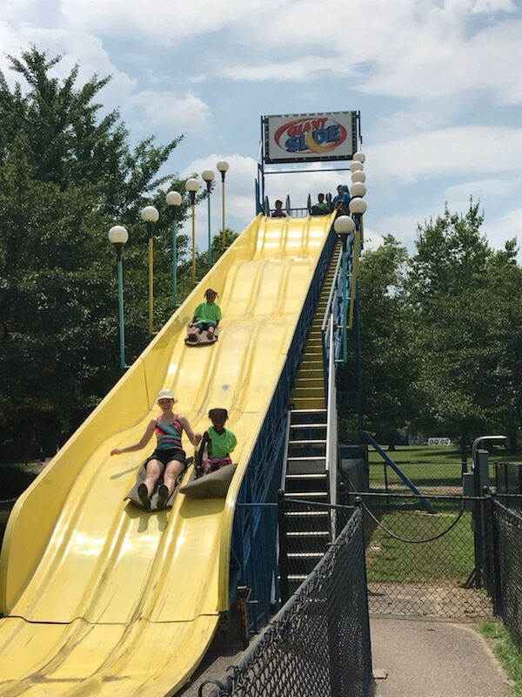
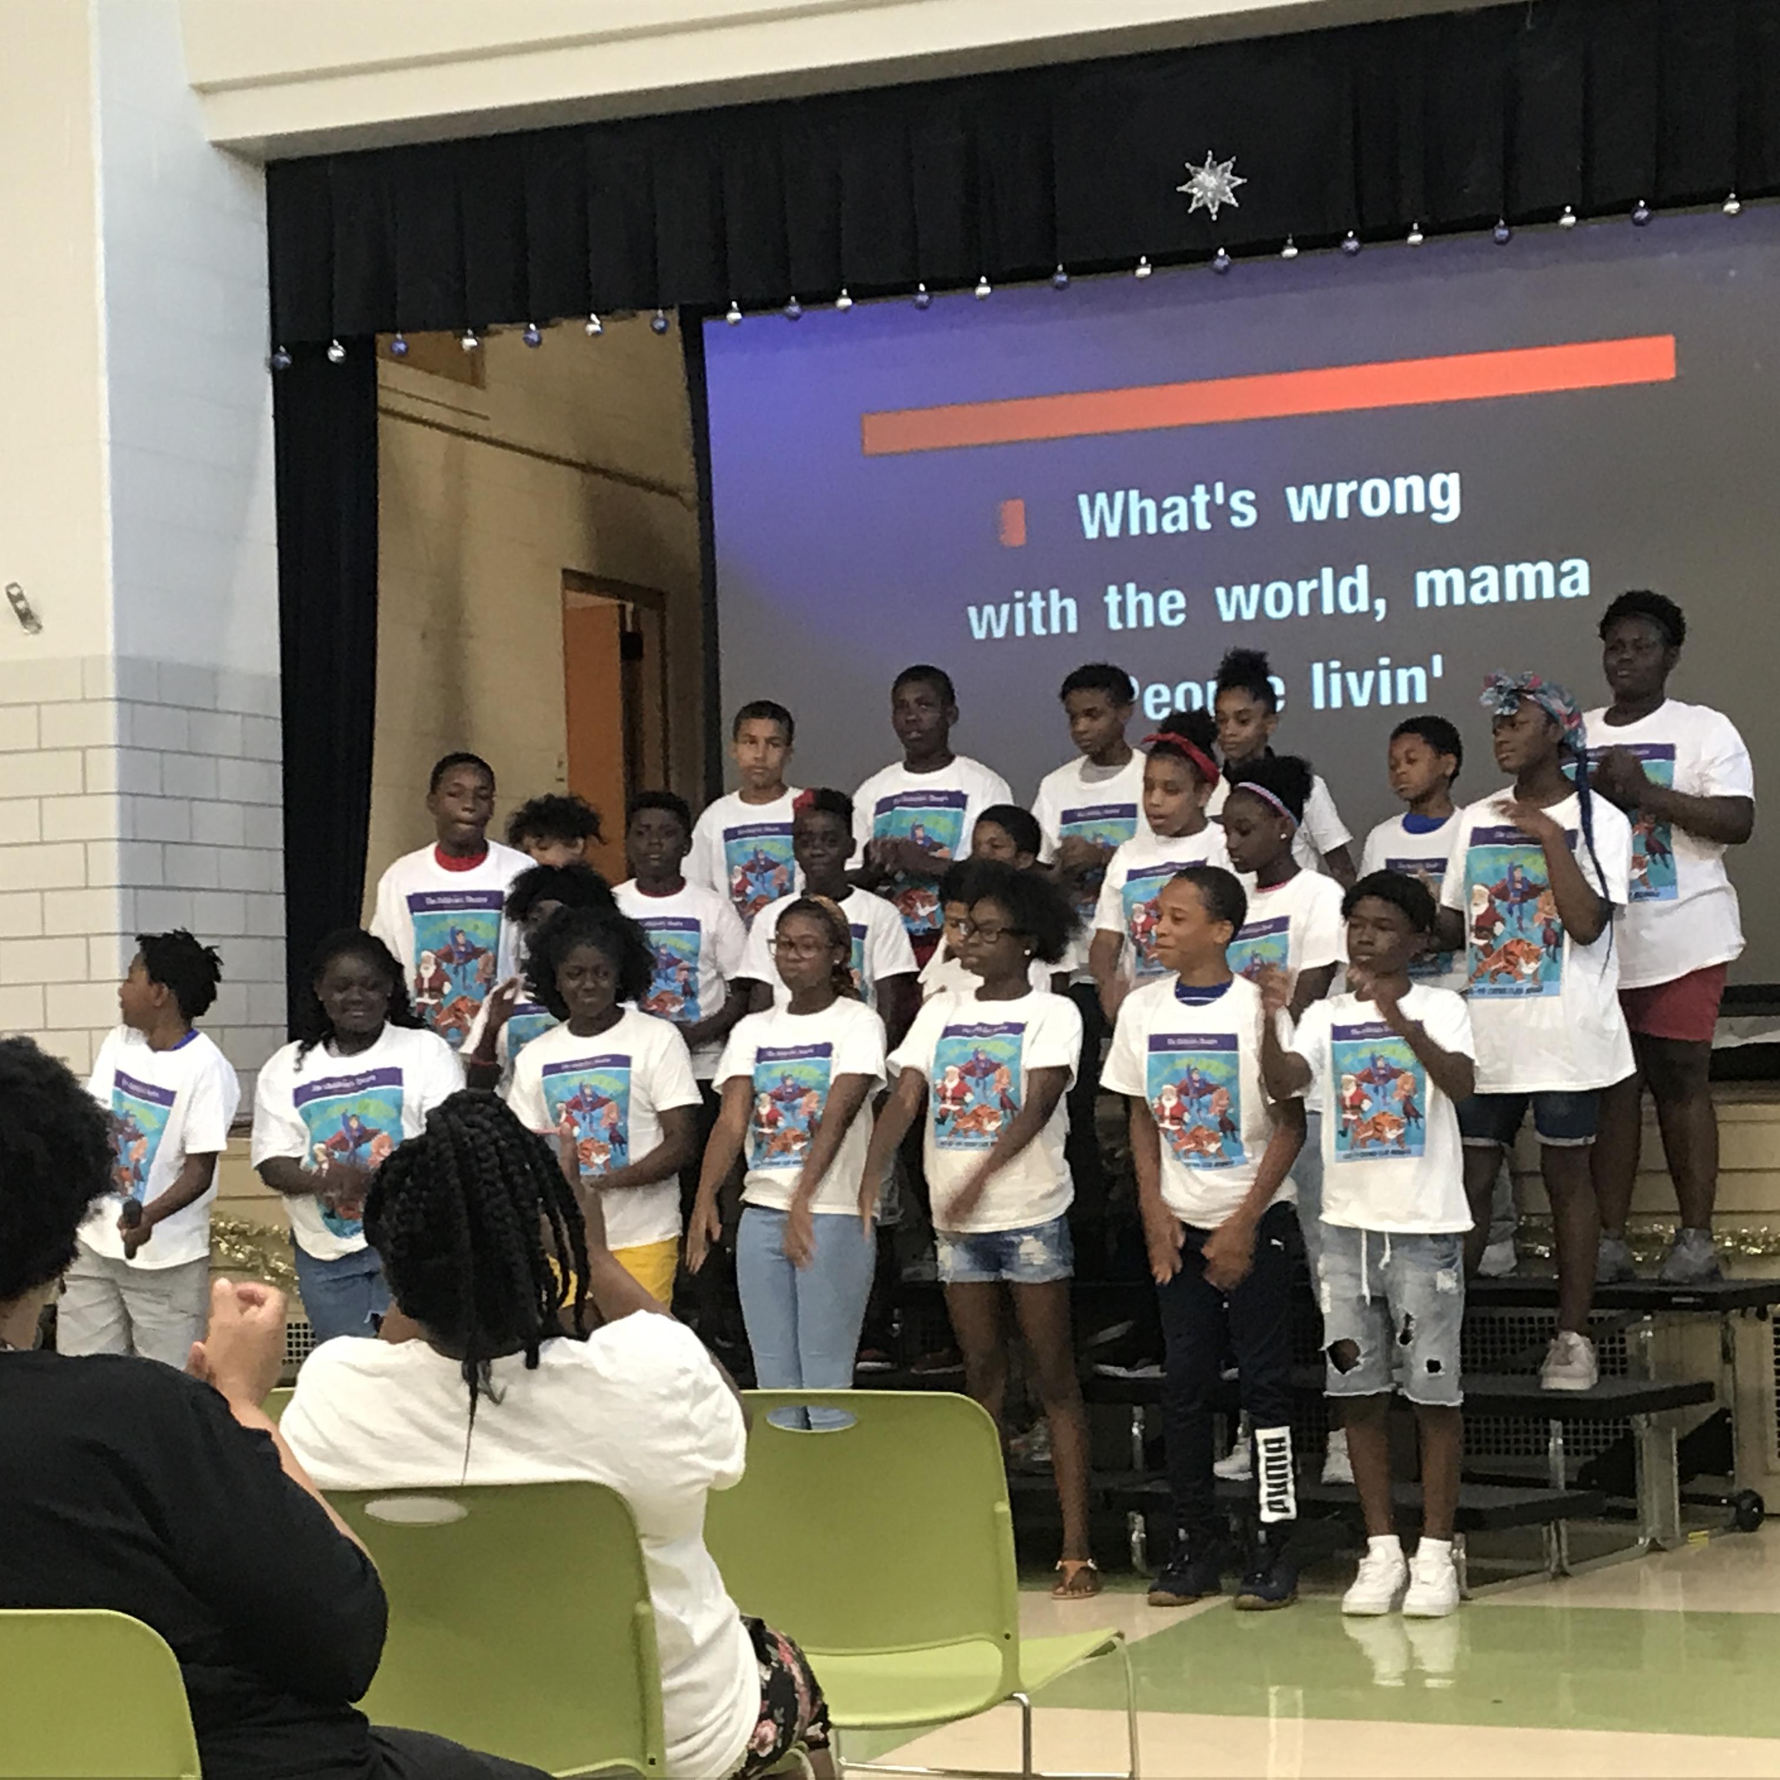
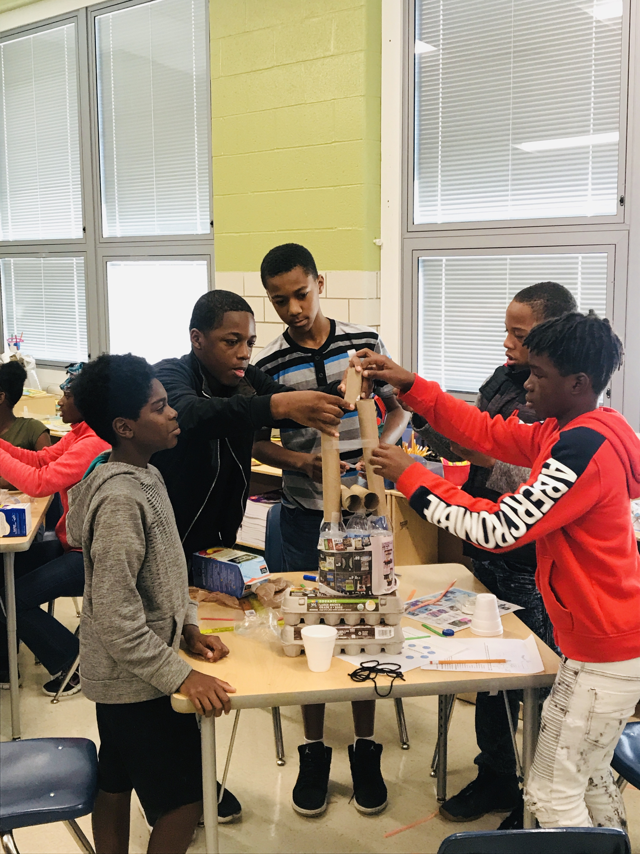
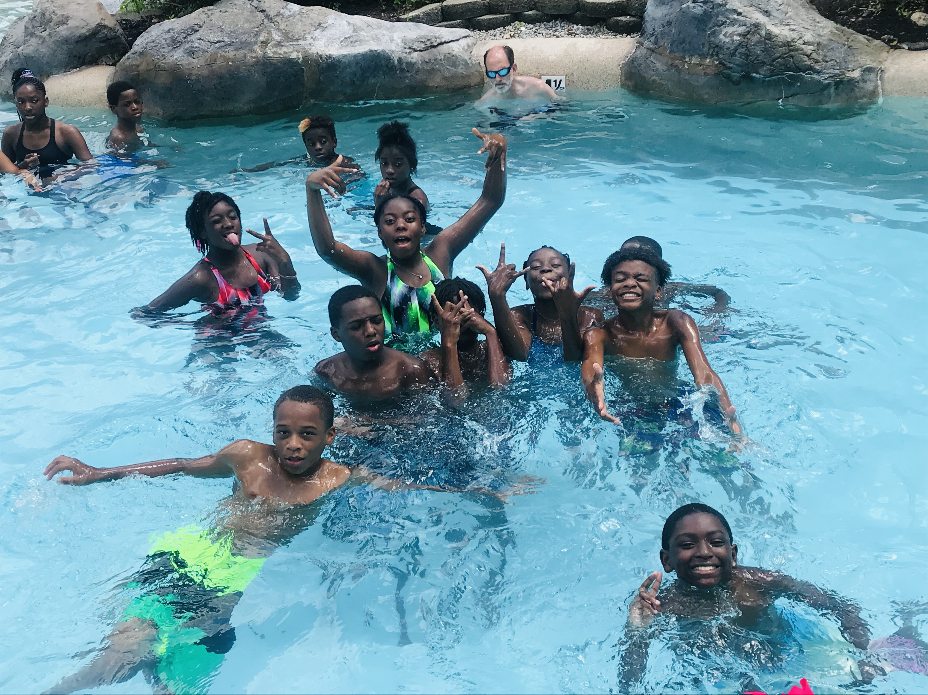
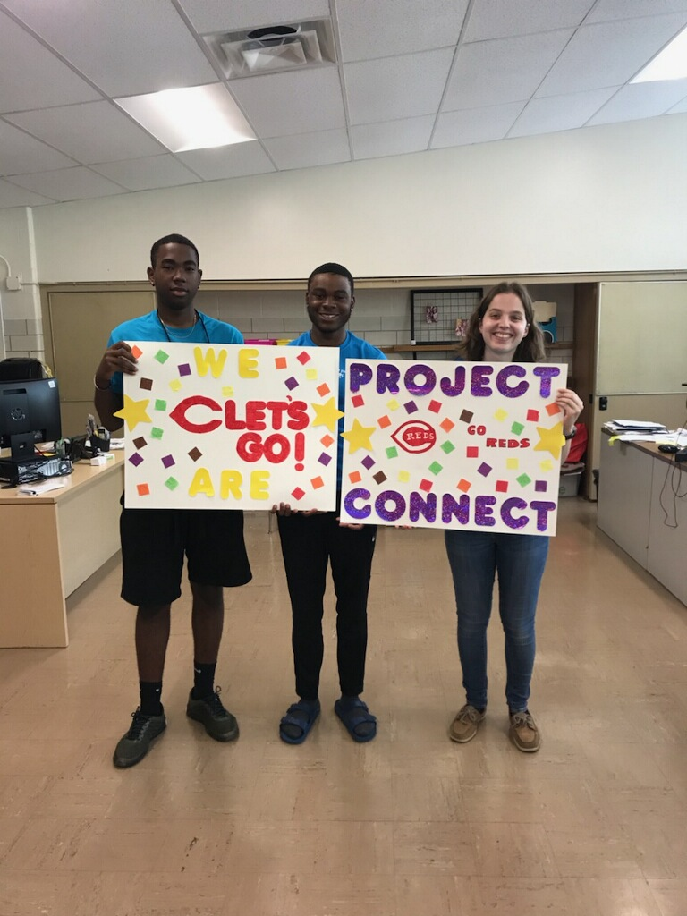
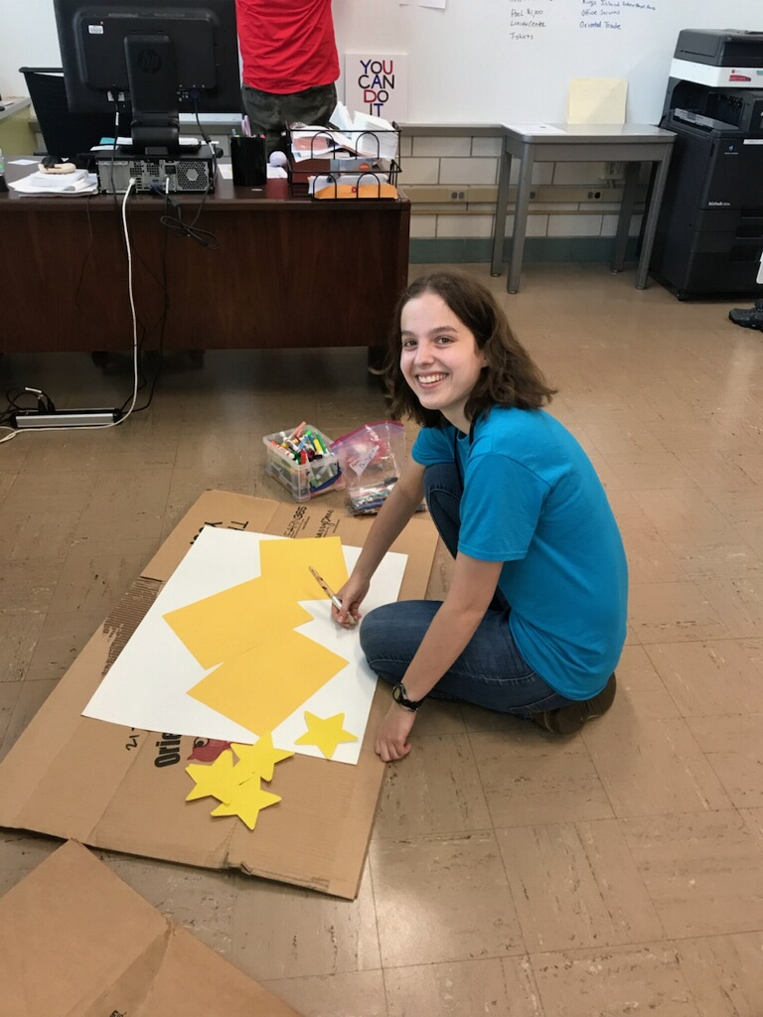
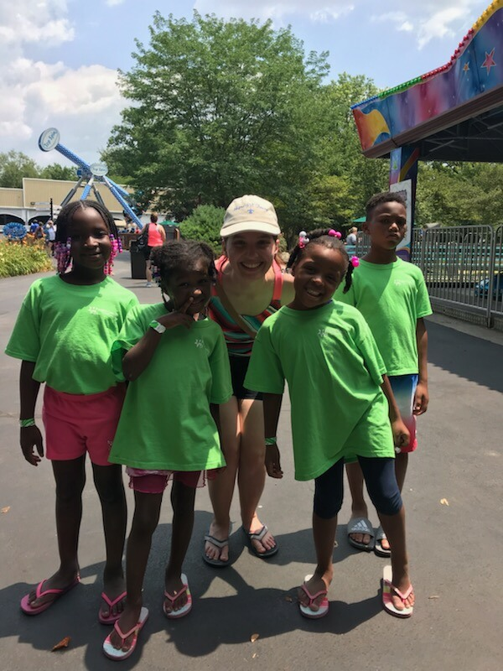
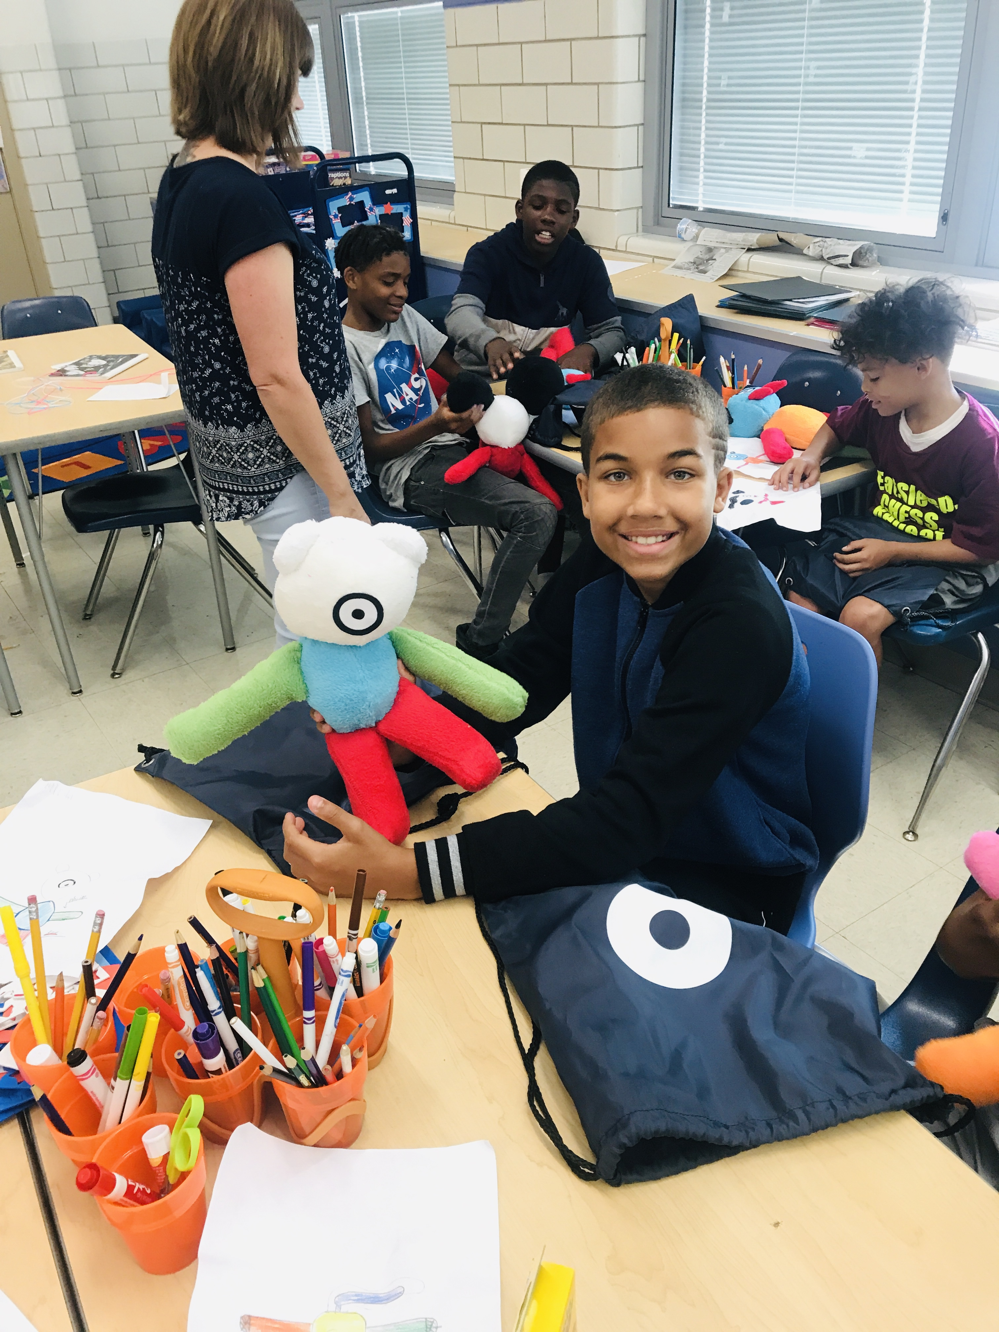
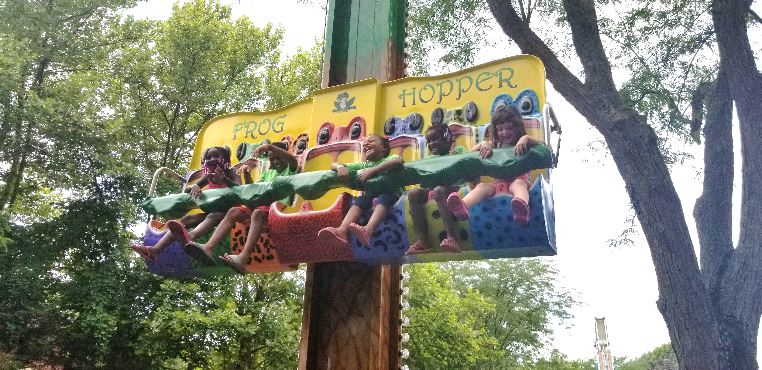
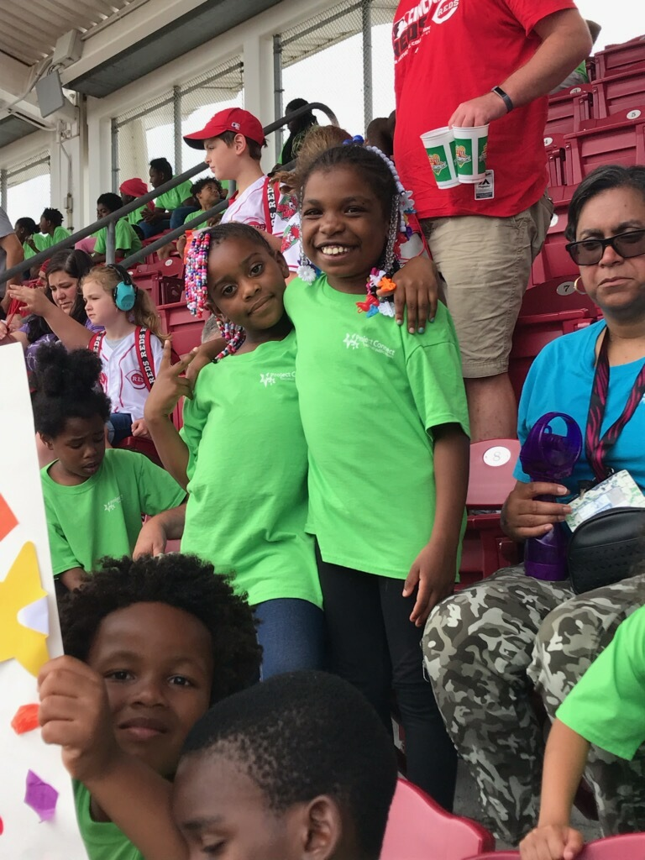
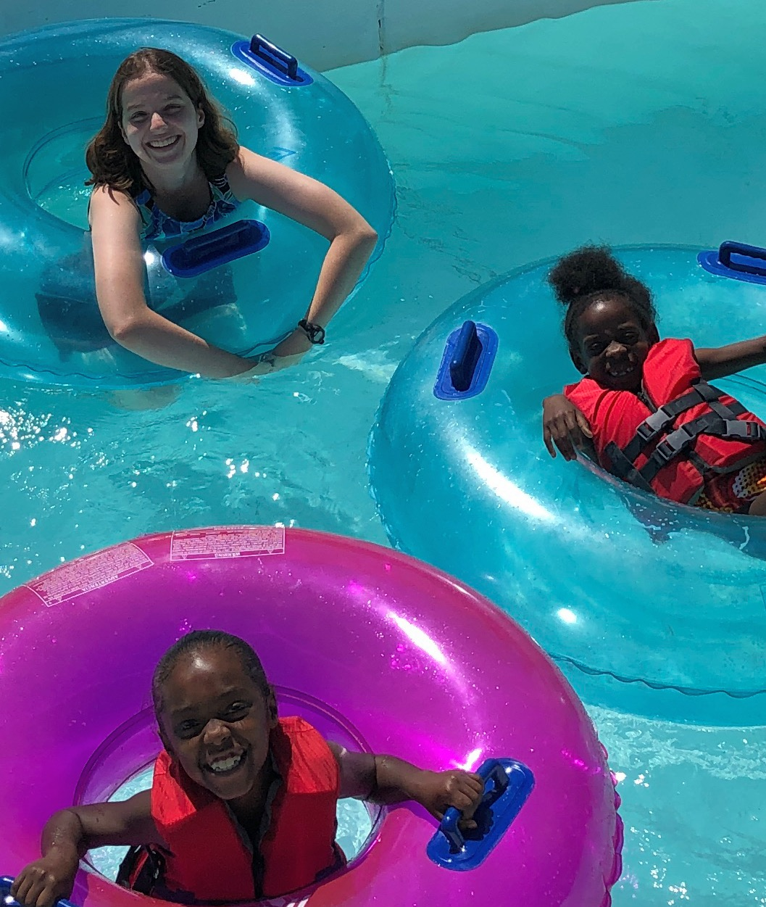
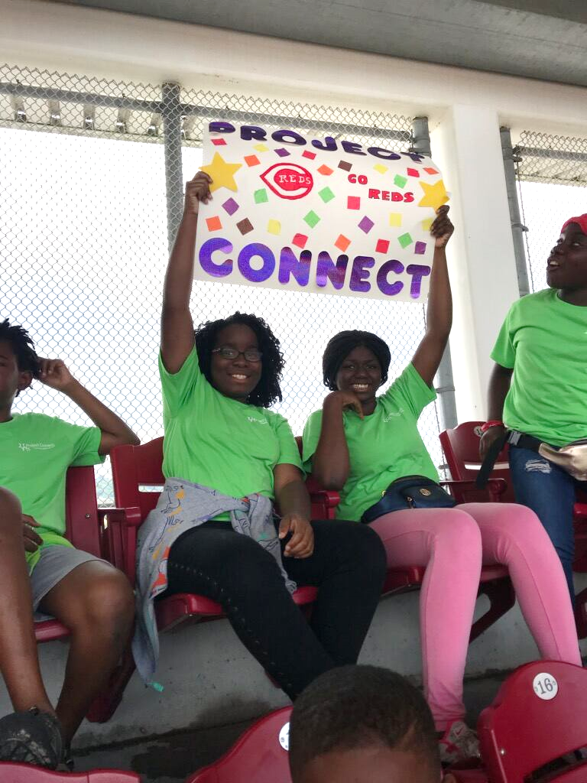
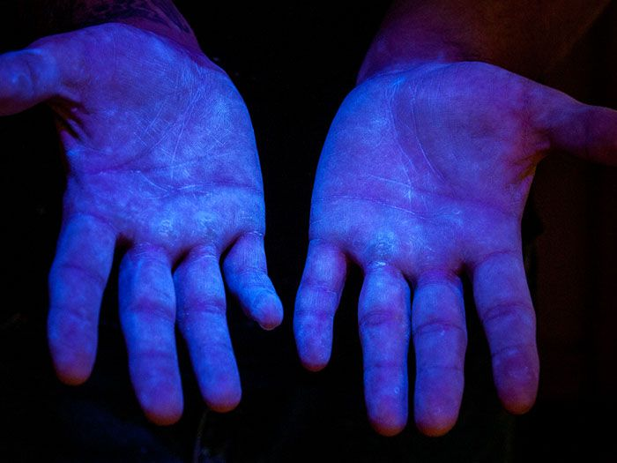
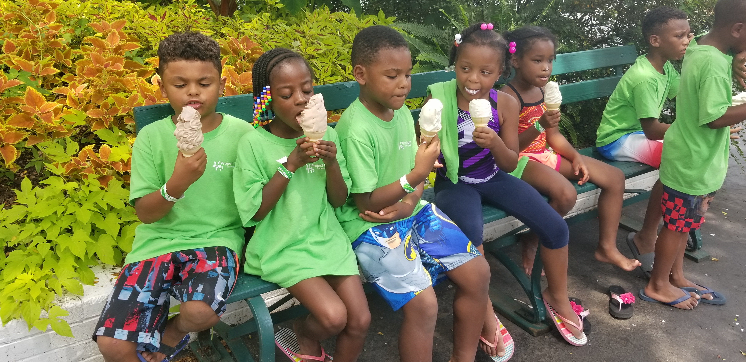
Serving Children Experiencing Homelessness
Cincinnati Public Schools’ Project Connect
Allie Pendery, University of Cincinnati College of Medicine
About the Site
Our Population
Even More Photos
Who: Since 1996, Project Connect has served children in the Cincinnati Public Schools who are experiencing homelessness.
What: They provide for students’ needs such as school supplies and uniforms, arrange access to transportation and educational resources, and advocate for the children.
When: Year-round, with a special 6-week summer academic and enrichment program.
Where: Currently based at Rising Stars Academy on Vine St.
Why: Every child deserves to have a quality education without worrying about meeting their basic needs.
We believe that the kids at Project Connect deserve as many fun and educational experiences as any other child might have at camp. Here’s some of the great stuff they did this summer:
They say a picture is worth 1000 words, and this is definitely true for Project Connect. Here are some more photos capturing this summer:
Petting a lizard during a visit from the Newport Aquarium…
Zooming down the Giant Slide at Coney Island…
My Role
Worked with students ages 5-7 at the summer program
Served as a leader and role model for the students
Assisted teacher inside and outside the classroom
Participated with the kids in all the awesome activities!
Final Thoughts
Special Project
Project Connect matters!
Data from the U.S. Department of Housing and Urban Development shows that on a single night in January 2018:
Over 500,000 people in the U.S. experienced homelessness.
20% of this total were children and 33% were families with children.
Teaching proper handwashing technique to students
Important because kids get sick a lot and germs spread fast in schools!
Using Glo Germ to find missed areas after washing
Floating along on the Lazy River at the Beach Waterpark…
Rooting for the team at the Reds game…
And much more, including:
Reading & math
Singing & dancing
Cooking
Swimming
Learning about nature
Leadership
Acknowledgements
Special thanks to Mrs. Renita Lewis-Jackson and Mr. Mark Gooch, the teachers whom I worked with every day, and to all of the other incredible Project Connect staff.

